Slide 1

WEB Development
Grade 7&8

Slide 2
Recap of the last Class
Notes:
Objective:
Review the previous lesson on HTML Forms.
Introduce the new topic: Navbar and Hero Section.
Teacher Instructions:
Recap the purpose of HTML forms.
Highlight the different types of form elements and their uses.
Emphasize the importance of styling forms for better user experience.
Introduce today's topic:
Navbar:
The navbar (navigation bar) is a crucial component of any website, providing users with easy access to different sections of the site. It helps in improving the user experience by making navigation intuitive and straightforward.
Hero Section:
The hero section is the prominent, eye-catching part of a webpage, usually located at the top. It serves to grab the user's attention and communicate the primary message or call to action.

Slide 3
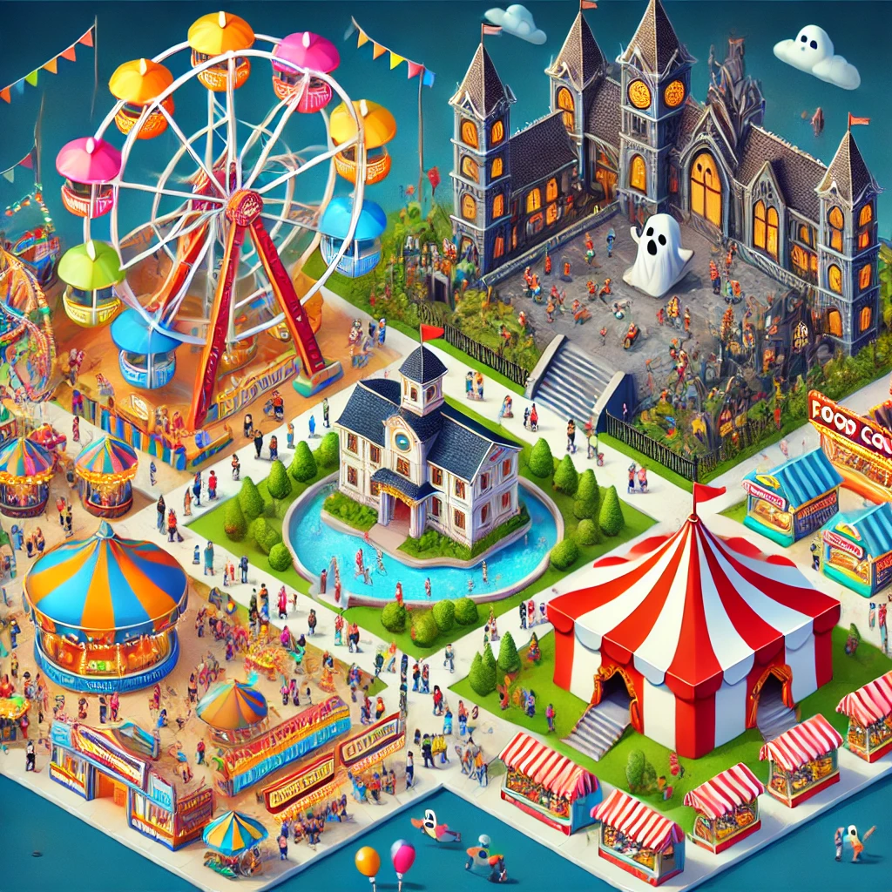
Festiville Puzzle
In Festiville, the 98th Percentile Carnival had three main attractions: the Ferris Wheel, the Haunted House, and the Food Court. However:
The Ferris Wheel couldn't be near the Haunted House because the noise would scare the riders.
The Haunted House couldn't be near the Food Court because it would ruin appetites.
Riddle: How can Mia organize these attractions without causing any issues?
Notes:
Solution:
Place the Ferris Wheel in one corner.
Place the Haunted House in the opposite corner.
Place the Food Court in between them.
This arrangement keeps all attractions enjoyable for everyone.
Objective:
Engage students with a problem-solving activity.
Teacher Instructions:
Present the riddle:
Introduction:
"In Festiville, the 98th Percentile Carnival had three attractions: the Ferris Wheel, the Haunted House, and the Food Court."
Conditions:
"The Ferris Wheel can't be near the Haunted House because the noise scares riders."
"The Haunted House can't be near the Food Court because it ruins appetites."
Challenge:
"How can Mia, the carnival manager, organize these attractions without causing any issues?"

Slide 4
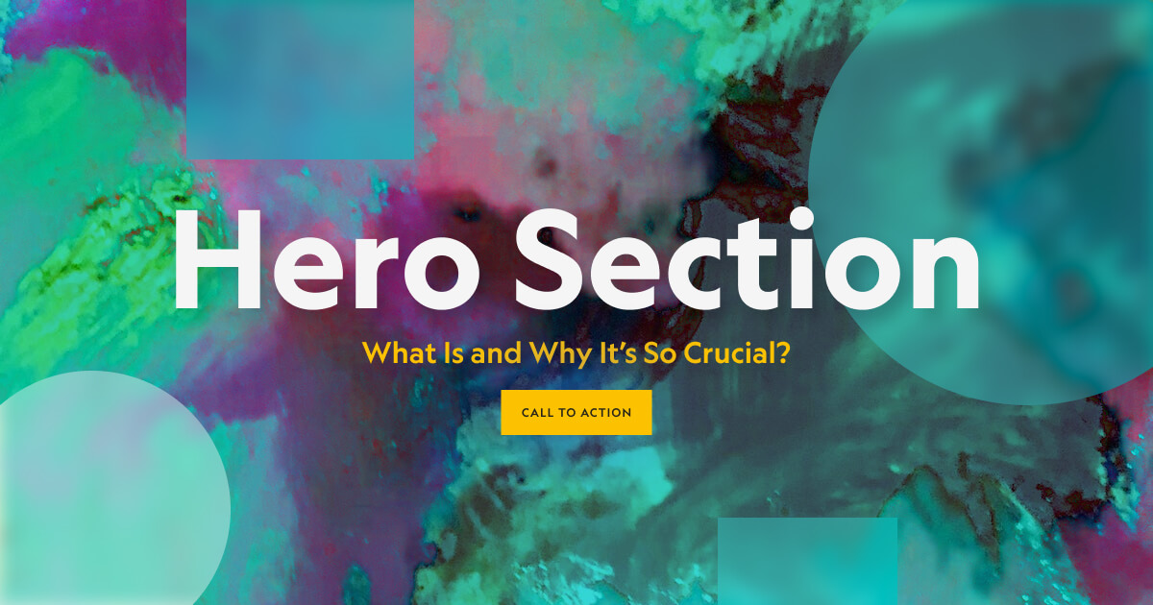
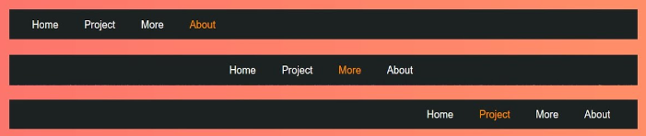
Introduction to Navigation and Hero Section
Notes:
Objective:
Introduce the concept of navigation and hero sections in web design.
Teacher Instructions:
Show the Images:
Navigation Bar:
Hero Section:
Explain the Navigation Bar:
"The navbar helps users navigate the website, providing links to key sections like Home, About, Gallery, Services, and Contact."
Discuss the Hero Section:
"The hero section is the first thing visitors see, featuring a headline, subheadline, and call-to-action button to engage them immediately."
Encourage Exploration:
"Think about how effective navigation bars and hero sections enhance user experience on websites."

Slide 5
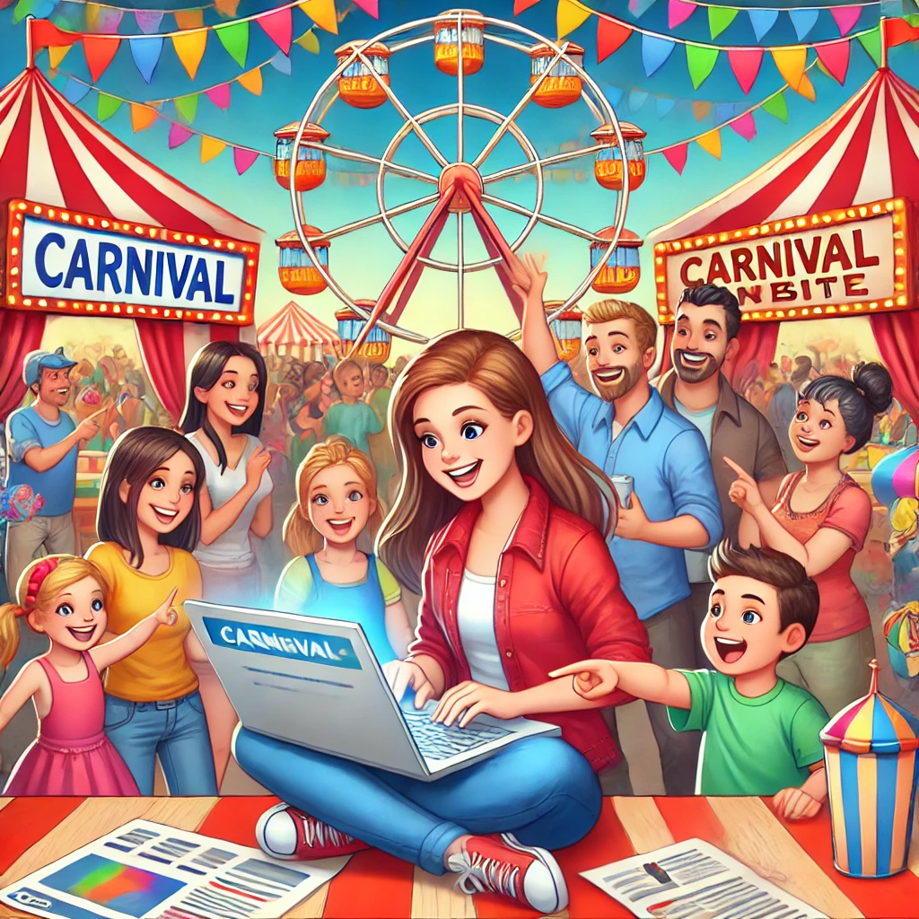
The Carnival Website Dilemma
In the lively town of Festiville, the 98th Percentile Carnival's website needed an urgent update. Emily, a bright and tech-savvy fifth-grader, was given the responsibility to enhance the website and make it more engaging.
Emily faced two main issues:
Information Access: Visitors struggled to find the information they needed quickly.
Lack of Excitement: The homepage didn't capture the carnival's vibrant spirit, causing visitors to lose interest.
Emily initially thought of updating each part of the website manually, but she realized this would be too time-consuming with the carnival approaching soon. She needed a more efficient solution to ensure the website was both user-friendly and exciting.
What could Emily do to quickly and effectively revamp the website, making it easy for visitors to find information and feel excited about the carnival?
Notes:
Objective:
Engage students with a problem-solving activity about improving a website's navigation and hero section.
Teacher Instructions:
Introduction:
Present the riddle:
"In Festiville, the 98th Percentile Carnival's website needed an update. Emily, a tech-savvy fifth-grader, was tasked with making it more engaging."
Present the Problem:
Visitors couldn't easily find information.
The homepage didn't capture the carnival's excitement.
Engage Students:
Brainstorm solutions for Emily to quickly and effectively improve the website.
Discuss the importance of a clear navigation bar for easy access to information.
Highlight the role of an engaging hero section in capturing visitors' interest.

Slide 6
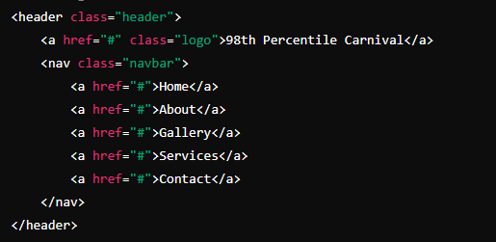
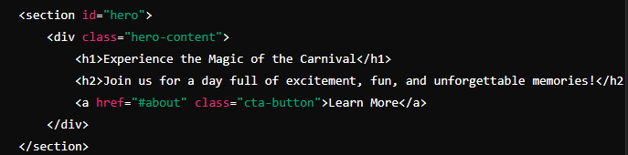
Introduction to Navigation and Hero Section
Emily created a stunning carnival website with a user-friendly navigation bar and an engaging hero section, ensuring visitors could easily find information and feel excited about the event.
Notes:
Objective:
Explain the basic structure of HTML forms
Teacher Instructions:
Show the screenshot of the Navigation and Hero Section syntax.
Explain the key elements of a Navigation Bar:
The <header> tag contains the navigation bar.
The .header class styles the header, aligning items with flexbox.
The logo is a clickable link styled with the .logo class.
The <nav> element contains links to different sections of the website.
Each link is styled for clear navigation.
Hero Section:
The <section> tag with the id="hero" creates the hero section.
The .hero-content class centers the content and adds text styling.
The hero section includes a main headline (<h1>), a subheadline (<h2>), and a call-to-action button (<a>).
The background image and overall layout create an engaging entry point to the website.

Slide 7
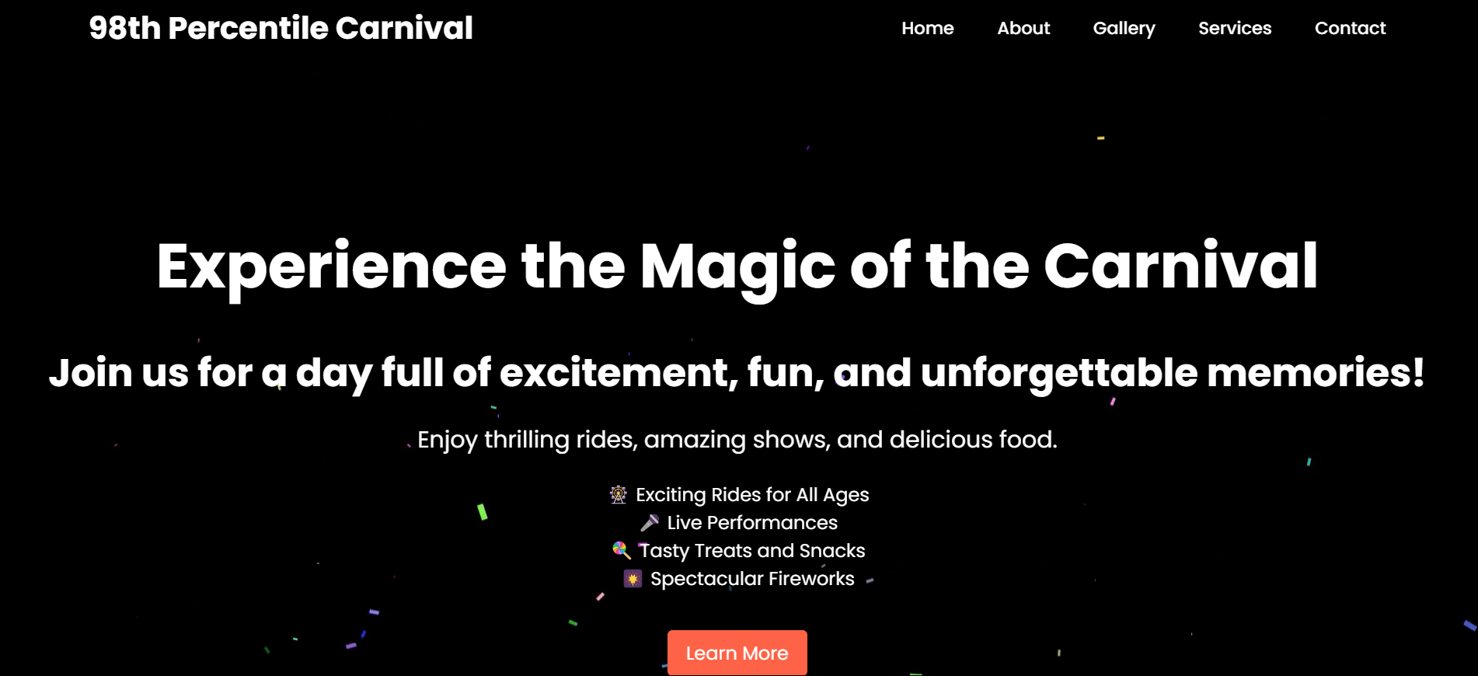
Project – Welcome to the 98th Percentile Carnival!
Notes:
Project Link: 98th percentile carnival
Objective:
Present the final project example.
Teacher Instructions:
Show the Screenshot:
Display the screenshot of the final project example.
Show the Project in Live Action:
Demonstrate the project on a live website to show how it functions.
Navigate through the website to showcase the navigation bar and hero section in action.
Emphasize the importance of both elements in creating an engaging and easy-to-use website.
Explain the Project:
Inform students that they will create a similar project.
Highlight the key features:
A clear and user-friendly navigation bar.
An engaging hero section with a headline, subheadline, and call-to-action button.

Slide 8
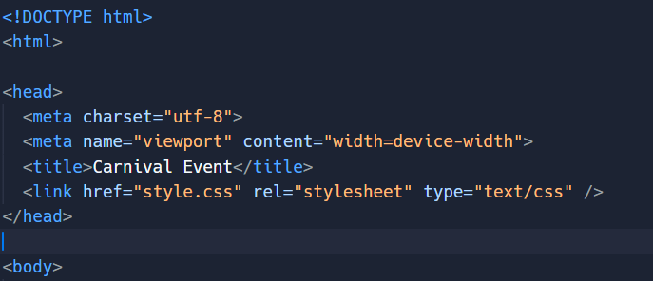
Working with the Project
HTML Code Explanation
Basic Structure of an HTML Document
Notes:
"Teacher's Activity"
Objective:
Explain the basic structure of an HTML document.
Teacher Instructions:
Display the screenshot of the HTML code.
Provide an overview of the basic structure:
<!DOCTYPE html>: Specifies HTML5.
<html lang="en">: Starts the HTML document with English language.
<head>: Contains meta-information.
Various meta tags for character set, viewport, and title.
<link>: Links to an external CSS file.

Slide 9
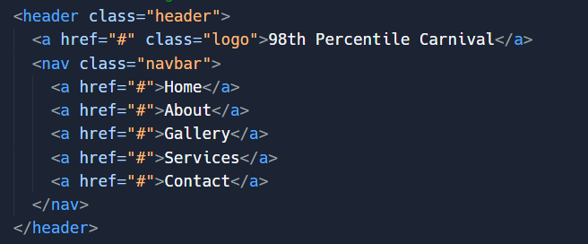
Working with the Project
Adding Navbar:
Notes:
Objective:
Navbar:
Helps users navigate the website easily.
Provides quick access to important sections.
Teacher Instructions:
Show how the navigation bar looks and functions on a live website.
Demonstrate the hover effect on links and how it improves user experience.
Tag Explanation:
<header>
Defines the header.
Class: header for styling.
<a>
Purpose: Creates a hyperlink
Attributes:
href="#" - Placeholder link.
class="logo" - Logo styling.
<nav>
Purpose: Container for navigation links.
Class: navbar for styling.
Navigation Links (<a>)
Purpose: Creates navigation links.
Attributes: href="#" - Placeholder links.

Slide 10
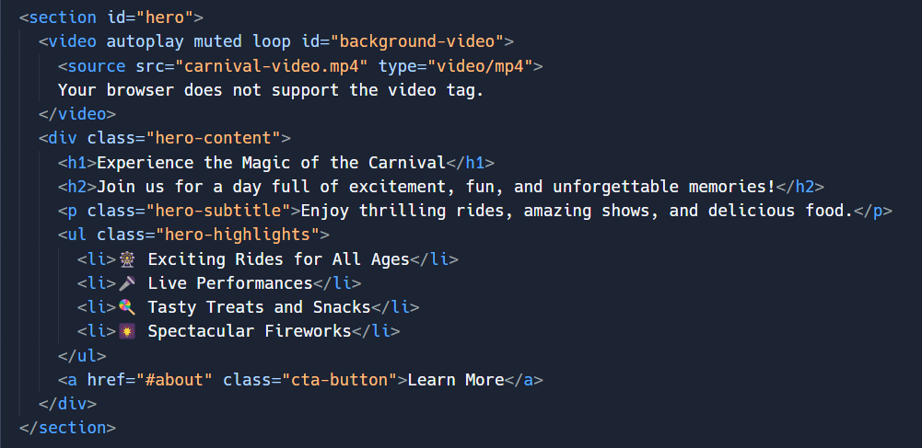
Working with the Project
Adding Hero Section and video:
Notes:
Objective:
Hero Section:
Captures visitors' attention immediately.
Communicates the main message and call-to-action.
Teacher Instructions:
Show how the hero section looks and functions on a live website.
Demonstrate the impact of a strong headline, subheadline, and call-to-action button.
Tag Explanation:
<section>
- Defines the hero section.
- ID: `hero` for styling.
<video>
- Background video.
- Attributes:
- `autoplay` - Plays automatically.
- `muted` - No sound.
- `loop` - Repeats continuously.
- ID: `background-video` for styling.
<source>
- Specifies video file.
- Attributes:
- `src="carnival-video.mp4"` - Path to video file.
- `type="video/mp4"` - Video format.
<div>
- Container for hero content.
- Class: `hero-content` for styling.
<h1>
- Main headline.
- Text: "Experience the Magic of the Carnival"
<h2>
- Subheadline.
- Text: "Join us for a day full of excitement, fun, and unforgettable memories!"
<p>
- Subtitle.
- Class: `hero-subtitle` for styling.
- Text: "Enjoy thrilling rides, amazing shows, and delicious food."
<ul>
- List of highlights.
- Class: `hero-highlights` for styling.
<li>
- List items for highlights.
- Text: Various highlights (e.g., 🎡 Exciting Rides for All Ages)
<a>
- Call-to-action button.
- Attributes:
- `href="#about"` - Link to about section.
- Class: `cta-button` for styling.
- Text: "Learn More"

Slide 11
Html Structure Done
Let's Style it Now
Notes:
Objective:
Review the code till now
Teacher Instructions:
Recap the key points.
Encourage interactive discussion and exploration of form elements like text inputs, checkboxes, and submit buttons.

Slide 12
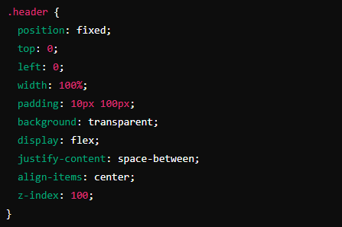
Working with the Project
CSS Code Explanation
Styling the Header
Notes:
Objective:
Explain the CSS code for styling the header of the webpage.
Teacher Instructions:
Display the screenshot of the CSS code.
Explain the styling for the header:
position: fixed;: Keeps the header fixed at the top of the page.
top: 0; left: 0; width: 100%;: Ensures the header spans the full width of the page.
padding: 10px 100px;: Adds padding for spacing.
background: transparent;: Sets a transparent background.
display: flex; justify-content: space-between; align-items: center;: Uses flexbox for layout.
z-index: 100;: Ensures the header stays on top of other elements.

Slide 13
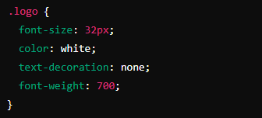
Working with the Project
Styling the logo
Notes:
Objective:
Explain the CSS code for styling the form container.
Teacher Instructions:
Display the screenshot of the CSS code.
Explain the styling for the logo:
font-size: 32px;: Sets the font size.
color: white;: Sets the text color to white.
text-decoration: none;: Removes the underline from the link.
font-weight: 700;: Makes the text bold.

Slide 14
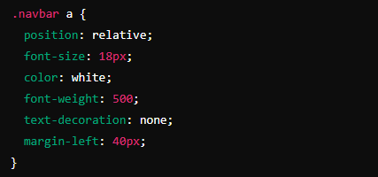
Working with the Project
Styles the navigation link
Notes:
Objective:
Explain the CSS code for styling the navigation link.
Teacher Instructions:
Display the screenshot of the CSS code.
Explain the styling for the navigation link:
position: relative;: Positions the link relatively.
font-size: 18px;: Sets the font size.
color: white;: Sets the text color to white.
font-weight: 500;: Sets the font weight.
text-decoration: none;: Removes the underline from the link.
margin-left: 40px;: Adds left margin for spacing.

Slide 15
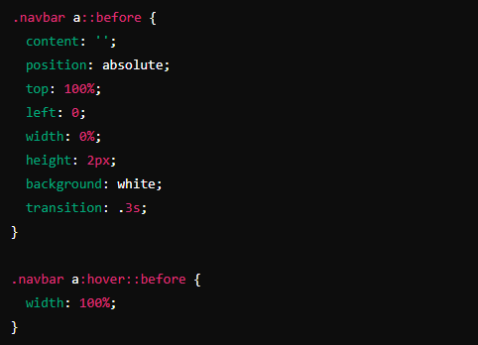
Working with the Project
Adds a hover effect to the navigation links
Notes:
Objective:
Explain the CSS code to Adds a hover effect to the navigation links.
Teacher Instructions:
Display the screenshot of the CSS code.
Explain the styling for the navigation link:
.navbar a::before: Creates a pseudo-element before the link.
content: '';: No content, just a styling element.
position: absolute; top: 100%; left: 0;: Positions the pseudo-element below the link.
width: 0%; height: 2px;: Initially sets the width to 0 and height to 2px.
background: white;: Sets the background color to white.
transition: .3s;: Adds a transition effect.

Slide 16
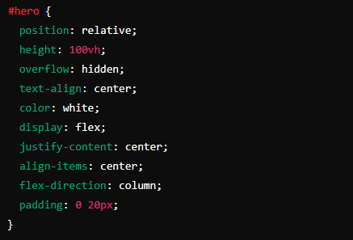
Working with the Project
Styles the hero section
Notes:
Objective:
Explain the CSS code to Styles the hero section.
Teacher Instructions:
Display the screenshot of the CSS code.
Explain the styling for the hero section:
position: relative;: Positions the hero section relatively.
height: 100vh;: Sets the height to 100% of the viewport height.
overflow: hidden;: Hides overflow content.
text-align: center;: Centers the text.
color: white;: Sets the text color to white.
display: flex; justify-content: center; align-items: center; flex-direction: column;: Uses flexbox for layout.
padding: 0 20px;: Adds horizontal padding.

Slide 17
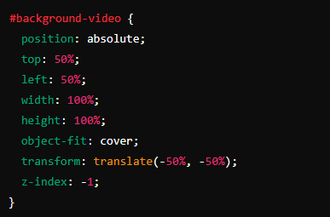
Working with the Project
Styles the background video
Notes:
Objective:
Explain the CSS code to Styles the background video.
Teacher Instructions:
Display the screenshot of the CSS code.
Explain the styling for the background video:
position: absolute; top: 50%; left: 50%;: Positions the video in the center.
width: 100%; height: 100%;: Sets the width and height to fill the container.
object-fit: cover;: Ensures the video covers the entire container.
transform: translate(-50%, -50%);: Centers the video.
z-index: -1;: Places the video behind other content.

Slide 18
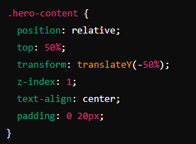
Working with the Project
Styles the container for the hero content
Notes:
Objective:
Explain the CSS code to Styles the hero content.
Teacher Instructions:
Display the screenshot of the CSS code.
Explain the styling for the hero content:
position: relative;: Positions the content relatively.
top: 50%; transform: translateY(-50%);: Vertically centers the content.
z-index: 1;: Places the content above the background video.
text-align: center;: Centers the text.
padding: 0 20px;: Adds horizontal padding.

Slide 19
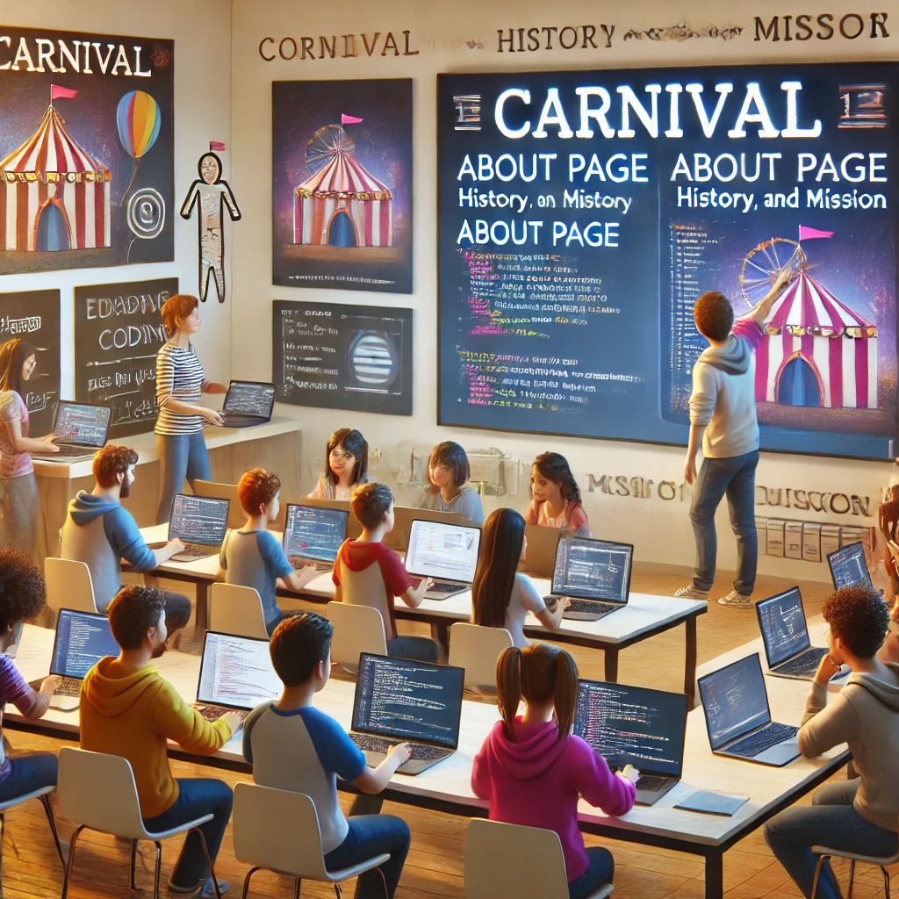
Now it's your turn!
Task: Complete the other pages any one out of the following
Home Page: Develop a comprehensive homepage with an overview of the carnival.
About Page: Provide information about the history and mission of the carnival.
Gallery Page: Include an interactive gallery showcasing images from past events.
Services Page: Detail the various services and attractions available at the carnival.
Contact Page: Create a contact form for visitors to reach out with inquiries or feedback.
Instructions: Share the code with others and work as a group to give your own personalization to the final web page.
Notes:
"Students' Activity"
Objective:
Allow students to use their creativity in designing each page. Suggest they add unique elements like maps, customer reviews, or event schedules.
Teacher Instructions:
Present the student activity task
Instruct student's to complete any one page out of the other's
Finally instruct all of them to share each other page code so everyone can complete the final project.

Slide 20

How to Save & Share the project.
Replit offers autosave option – so not worry about the same.
To share project with someone in view mode: just copy the link from the URL bar, and share the link
To share the project for collaboration
Click on "Invite" from the top right corner
If you know the username, type it in the box and click on invite
You can also turn on the toggle button "private join link" to create a public collaboration link and invite members to edit your code.
Notes:
Instructions for the Teacher:
Explain how to save and share projects on Replit, including the options for collaboration.
Emphasize the importance of sharing projects for feedback and collaboration.

Slide 21


What is the primary purpose of a navigation bar on a website?
A) To display images
B) To help users navigate the website
C) To show advertisements
D) To play background music
Notes:
Answer: B) To help users navigate the website

Slide 22
In the following code, what is the purpose of class="logo"?
A) To add a hyperlink
B) To style the logo
C) To create a paragraph
D) To add an image
Notes:
Answer: B) to style the Logo

Slide 23
Which CSS property is used to fix the navigation bar at the top of the page?
A) position: absolute;
B) position: relative;
C) position: fixed;
D) position: static;
Notes:
Answer: C) position: Fixed;

Slide 24
Which attribute is used to make a video autoplay in the hero section?
A) muted
B) loop
C) autoplay
D) controls
Notes:
Answer: C) autoplay

Slide 25

What have we learnt?
What We Learned Today
1. Navigation Bar:
2. Hero Section:
3. CSS Techniques:
4. Enhancing the Website:
5. Practical Application:
Notes:
Objective:
Summarize the key learnings from the lesson.
Teacher Instructions:
Review the key points learned in the lesson:
Navigation Bar:
Helps users navigate the website.
Created using the <nav> tag and styled with CSS.
Key CSS property: position: fixed; to keep it at the top of the page.
Hero Section:
Captures visitors' attention.
Defined using the <section> tag with an id="hero".
Includes a background video and styled text elements.
CSS Techniques:
Applied global styles and used Google Fonts.
Used flexbox for layout.
Added hover effects to navigation links.
Enhancing the Website:
Ideas: Make it responsive, add interactive elements, and create additional pages.
Practical Application:
Reviewed and practiced coding navigation bars and hero sections.
Reinforced learning with quizzes.

Slide 26

Homework Discussion
Notes:
Instructions for the Teacher: Facilitate a discussion about the homework assignment.

Slide 27

Brain Booster Bonus
Create a "Personal Website" using HTML and CSS.
Enhance the hero section of the website. The hero section should include a background image, a headline, a subheading, and a call-to-action button.
Notes:
Objective: Create a responsive "Personal Website" with a fixed navigation bar and an enhanced hero section using HTML and CSS.
Set Up HTML:
Create a basic HTML structure.
Add a <title> in the <head> section.
Navigation Bar:
Use a <header> element with a class of header.
Include an <a> tag with a class of logo for the site name.
Add a <nav> element with a class of navbar containing navigation links (<a> tags).
Hero Section:
Add a <section> element with an id="hero".
Inside, add a <div> with a class of hero-content.
Include an <h1> for the headline, an <h2> for the subheadline, and a call-to-action button (<a> with class cta-button).
Style with CSS:
Create a CSS file and link it in the HTML.
Apply global styles for font and reset margins.
Style the header to be fixed at the top.
Style navigation links and add hover effects.
Style the hero section with a background image, centered text, and a call-to-action button.
Use media queries for responsiveness.

Slide 28

Be Skeptical of Promises
If something online sounds too good to be true, like 'free games for life,' it could be a trick.
Oliver saw an ad online promising "free games for life" and eagerly clicked on it, hoping for a great deal.
Instead, his computer got infected with malware, causing a lot of problems.
The moral of the story: don't believe ads or emails promising free stuff without checking with an adult first, as it could be a trick.

